Slide 1


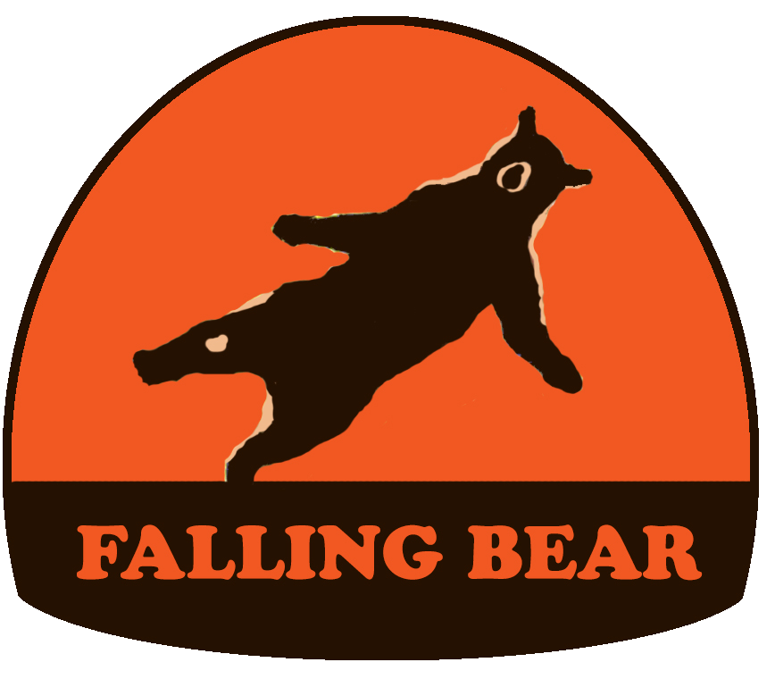
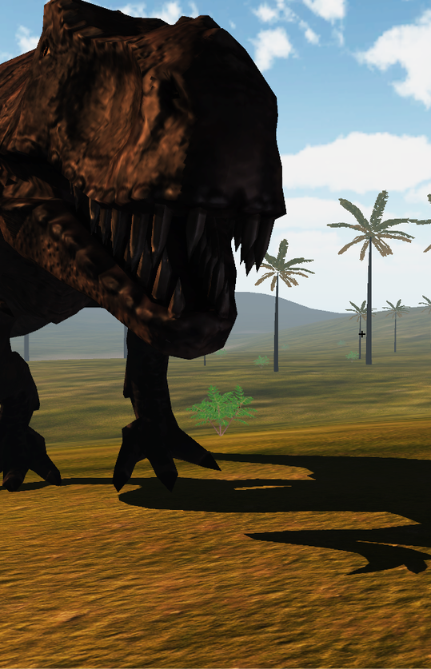
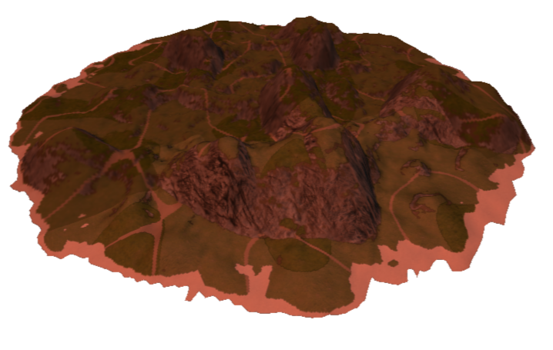
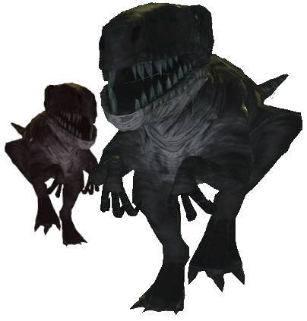
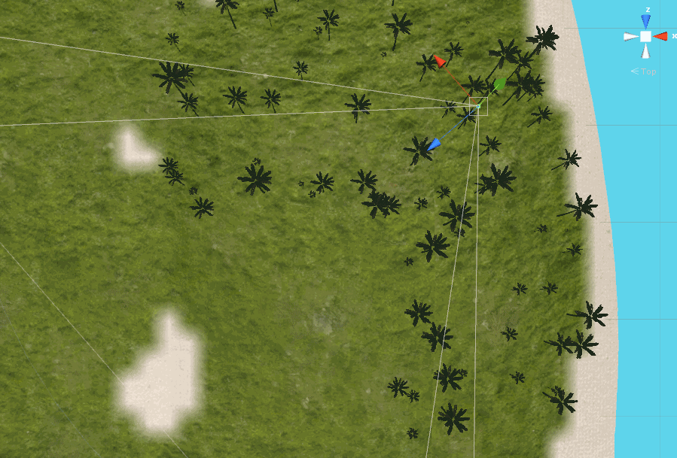
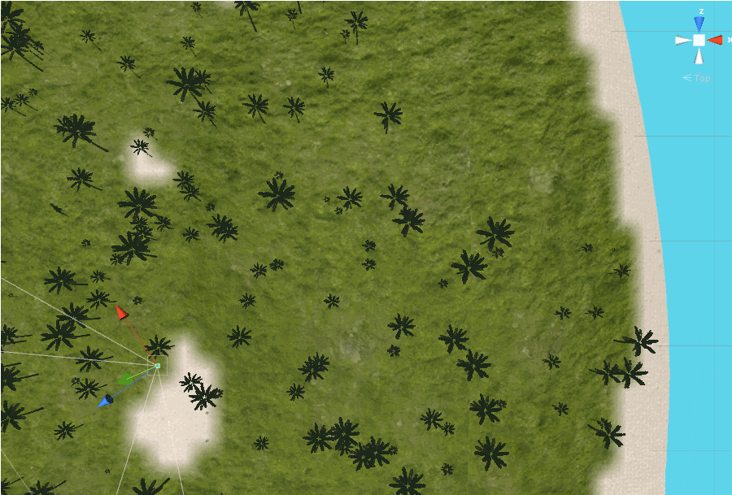
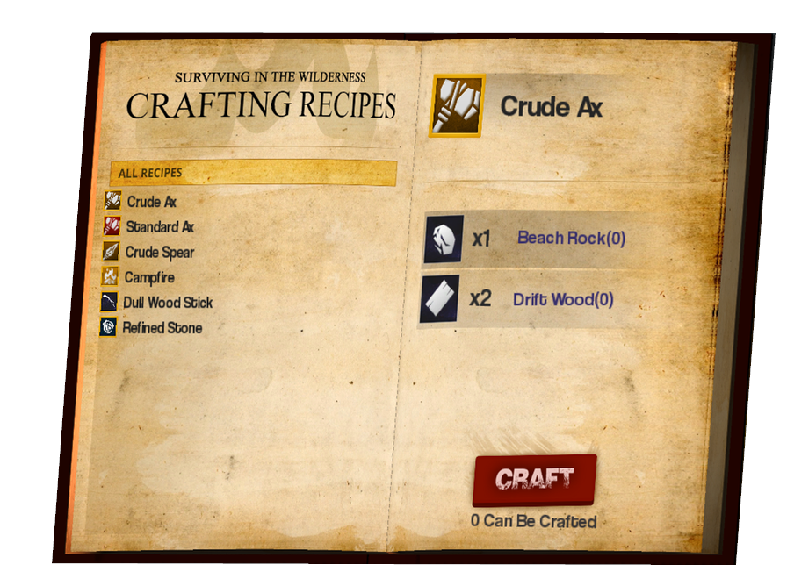
TECHNICAL POSTER
Department of Computer Science and Engineering
The Ohio State University
Quentin Bloomfield, Keegan Donnelly, Jacob Grealy, Zach Knickerbocker, Nate Niederkorn, Sean Peck
Procedural Island Generation
Dinosaur AI
Island generation starts with creating a height map for the terrain. This height map is created using a layered combination of fractals and simplex noise; it is constructed from bottom to top starting with large, tall, dense features and ending with sporadic, small, short features. Lastly a parabolic constraint is applied to give the island a dome
like shape ensuring that the
edge of the island drops off
gradually into the ocean.
The dinosaur AI uses waypoints to dynamically plan a dinosaur’s route around flora, players, enemies, and obstructive island terrain (e.g. mountains). Flocking and other group behaviors are implemented to give packs of dinosaurs an intimidating presence.
The Dinosaur Food Chain
Dinosaurs interact with the other dinosaurs on the island using a number of heuristics. One of the most important is a literal food chain which dictates a dinosaurs decision to pursue, eat, flee, etc. from other dinosaurs.
Terrain Texturing
Pack AI
The terrain of the island is textured using a combination of sampled height, slope, and simplex noise values. The slope value is used to determine where cliffs and dirt textures will be applied as vegetation becomes
less dense with slope increase. For lesser slope values the height
value is then used to split the terrain into three biomes of beach, meadow/jungle, and mountain. Finally, simplex noise is used to split
the meadow and jungle into two separate biomes.
“Pack AI”, as we’ve coined it, is an artificial intelligence which moves packs of dinosaurs around the island to simulate macro dinosaur travel behaviors, and keep the dinosaurs within reasonable distance from the player.
Flocking AI
While dinosaurs are typically found near others of their kind, they
usually act independently of one another. However, some packs
contain flocks of dinosaurs. Dinosaurs in a flock work together, and
alerting one of them means alerting all of the other flock members. To accomplish this behavior, we implemented a modified “Boids” flocking algorithm, Dinosaurs in flocks are incredibly dangerous, so be wary!
Custom LOD System
3D User Interface
A level of detail (LOD) system is implemented to manage both the level of graphical detail and level of interactivity of static (non-moving) objects based on their distance from the player. For example: nearby trees are physical objects with detailed models; far away trees are non physical objects with low resolution billboards. The LOD system divides the island into evenly sized square sectors arranged in a 2-dimensional array. All static objects are placed into these sectors based on their initial position in the world. Every few frames the sectors closest to the player recalculate and apply the LOD of all of the static objects contained within them.
Get Away’s graphical user interface elements have_ been designed using 3D models and text to give_ them a realistic presence in the game._ _
Data Driven Items & Crafting
Every item, island resource, and crafting recipe is. defined by an external JSON formatted data file..
This makes adding content to the game, and...
balancing existing content, quick and easy.._

Slide 2

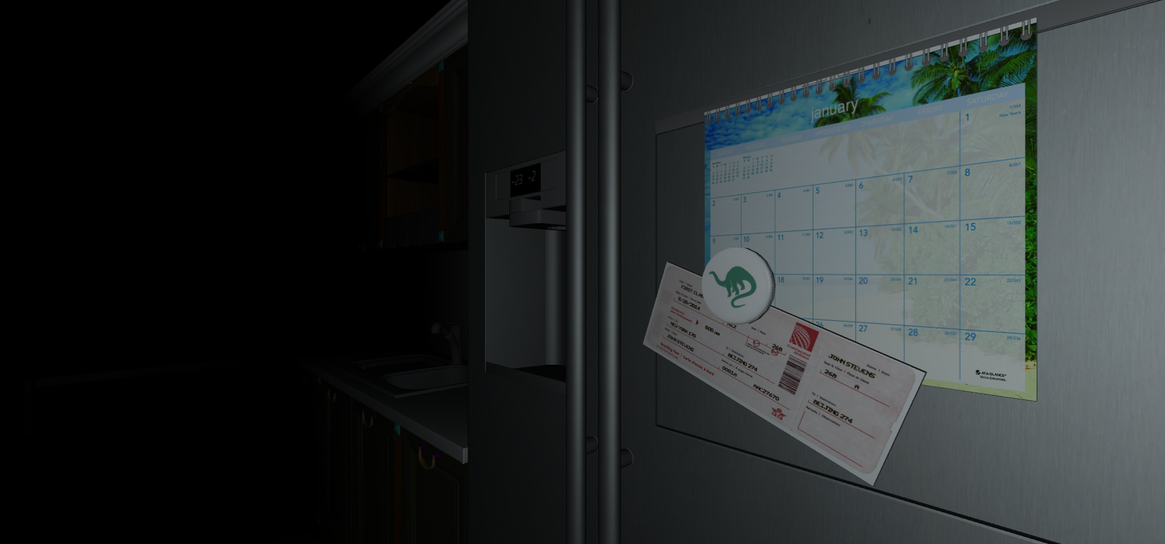




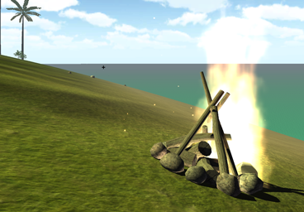

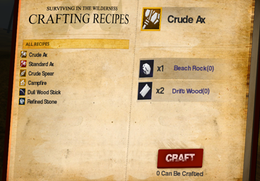


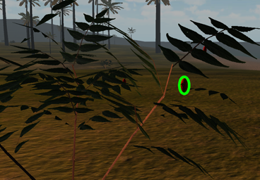

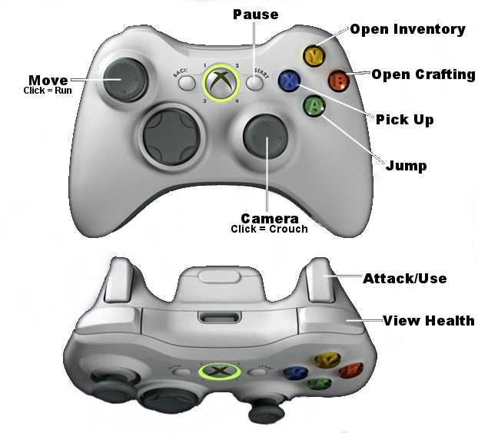

GAMEPLAY POSTER
Department of Computer Science and Engineering
The Ohio State University
Quentin Bloomfield, Keegan Donnelly, Jacob Grealy, Zach Knickerbocker, Nate Niederkorn, Sean Peck
Player Status
It’s time for a vacation.
Health
The setting for the game is a survival scenario. You've awoken on an island following a plane crash, and find yourself stranded with little resources in a dinosaur inhabited paradise. Weather the harsh conditions, collect and craft the survival tools you need, and ultimately attempt escape from the island. As quick as you can muster – “Get Away”!
Depletes when injured
Hunger
Depletes faster when running
Thirst
Depletes faster during the day
Sanity
Survive The Night
Depletes during the night
Craft a campfire, place it on the island, and then click it to quickly sleep through the night. This is a great way to replenish sanity, and avoid dinosaurs that crawl the island in the cover of darkness.
Weapons & Tools
Ax
Chop trees to get logs and other resources.
Craft Weapons and More
Spear
Crafting new items from the resources you collect around the island will enable your survival. Craft an axe to chop down a tree. Craft a spear the take down a dinosaur. The possibilities are many.
Take down dinosaurs with a thrust of your spear.
Bow & Arrow
Collect Resources
Shoot at dinosaurs from afar.
Resources for both crafting or consumption can be collected from the island. Some items are commonly available everywhere, whereas others are rarer and restricted to particular climates like the jungle.
Torch
The night is dark, but a torch will light your way.
Your Goal
Controller Mapping
Build the raft to escape the island!

